Slide 1
UNIT 6
Prof. KALYANI KARULE
Dept of CSE

Slide 2
Topics
IO Stream, Applets, Threads
Introduction to stream classes, use of stream classes, I/O stream, byte stream, character stream, predefined stream, reading console input, reading character, reading string.
Writing console output, the print write class, reading & writing files.
Transient and Volatile modifiers.
Introduction to applets, applet life cycle, creating and executing applets.
Introduction to multithreading, lifecycle of Thread, Runnable interface and Thread class.

Slide 3
Streams
Java programs perform I/O through streams. A stream is an abstraction that either produces or consumes information. A stream is linked to a physical device by the Java I/O system.
All streams behave in the same manner, even if the actual physical devices to which they are linked differ. Thus, the same I/O classes and methods can be applied to different types of devices. This means that an input stream can abstract many different kinds of input: from a disk file, a keyboard, or a network socket. Likewise, an output stream may refer to the console, a disk file, or a network connection.
Streams are a clean way to deal with input/ output without having every part of your code understand the difference between a keyboard and a network, for example. Java implements streams within class hierarchies defined in the java.io package.
3 streams are created for us automatically. All these streams are attached with the console.
1) System.out: standard output stream
2) System.in: standard input stream
3) System.err: standard error stream

Slide 4
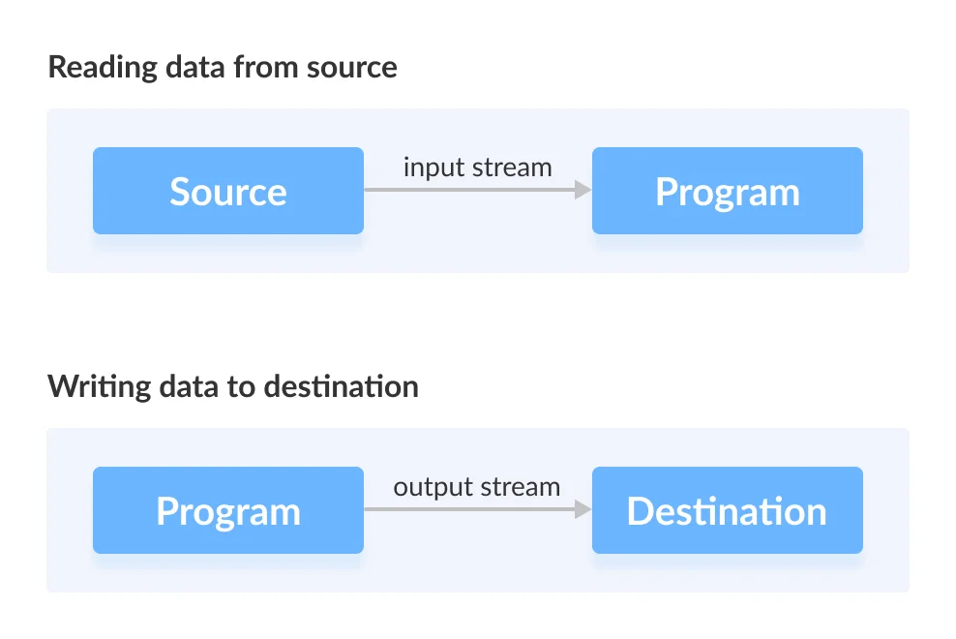
Java I/O Streams
In Java, streams are the sequence of data that are read from the source and written to the destination.
An input stream is used to read data from the source. And, an output stream is used to write data to the destination.
class HelloWorld {
public static void main(String[] args) {
System.out.println("Hello, World!");
}
}
For example, in our first Hello World example, we have used System.out to print a string. Here, the System.out is a type of output stream.
Similarly, there are input streams to take input.
Input stream reads data from source to program and output stream writes file from program to destination

Slide 5
Byte Streams and Character Streams
Java defines two types of streams: byte and character. Byte streams provide a convenient means for handling input and output of bytes. Byte streams are used, for example, when reading or writing binary data. Character streams provide a convenient means for handling input and output of characters. They use Unicode and, therefore, can be internationalized. Also, in some cases, character streams are more efficient than byte streams.
The original version of Java (Java 1.0) did not include character streams and, thus, all I/O was byte-oriented. Character streams were added by Java 1.1, and certain byte- oriented classes and methods were deprecated. Although old code that doesn’t use character streams is becoming increasingly rare, it may still be encountered from time to time. As a general rule, old code should be updated to take advantage of character streams where appropriate. One other point: at the lowest level, all I/O is still byte-oriented. The character-based streams simply provide a convenient and efficient means for handling characters.

Slide 6
Byte Stream
Byte stream is used to read and write a single byte (8 bits) of data. All byte stream classes are derived from base abstract classes called InputStream and OutputStream.
Java InputStream Class
Java OutputStream Class

Slide 7
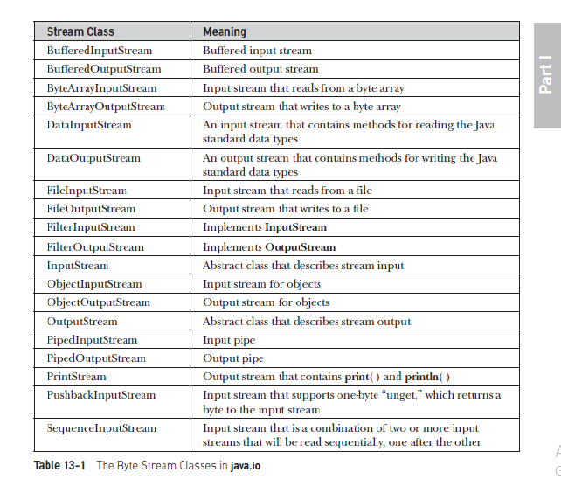
The abstract classes InputStream and OutputStream define several key methods that
the other stream classes implement. Two of the most important are read( ) and write( ),
which, respectively, read and write bytes of data. Each has a form that is abstract and must
be overridden by derived stream classes.

Slide 8
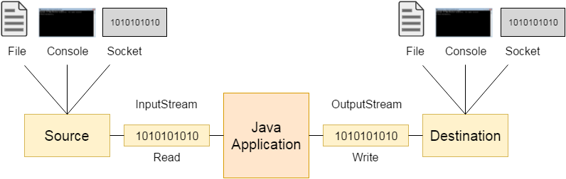
InputStream
Java application uses an input stream to read data from a source; it may be a file, an array, peripheral device or socket.
OutputStream
Java application uses an output stream to write data to a destination; it may be a file, an array, peripheral device or socket.
Let's understand the working of Java OutputStream and InputStream by the figure given below.

Slide 9
Character Stream
Character stream is used to read and write a single character of data. All the character stream classes are derived from base abstract classes Reader and Writer.
Java Reader Class
Java Writer Class

Slide 10
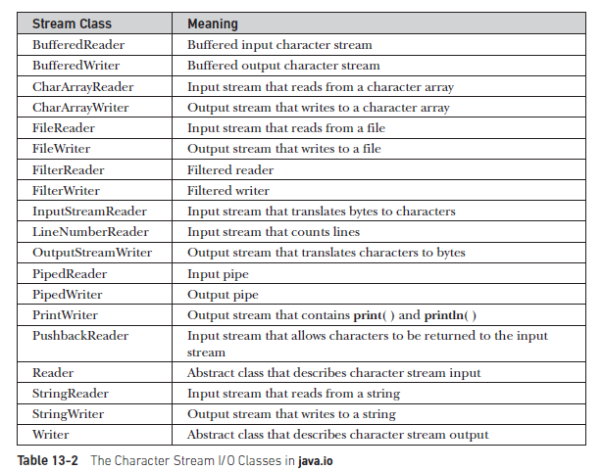
The abstract classes Reader and Writer define several key methods that the other stream
classes implement. Two of the most important methods are read( ) and write( ), which read
and write characters of data, respectively. Each has a form that is abstract and must be
overridden by derived stream classes.

Slide 11
Java Reader Class
The Reader class of the java.io package is an abstract superclass that represents a stream of characters.
Since Reader is an abstract class, it is not useful by itself. However, its subclasses can be used to read data.
Subclasses of Reader
In order to use the functionality of Reader, we can use its subclasses. Some of them are:
BufferedReader
InputStreamReader
FileReader
StringReader

Slide 12
Java Writer Class
The Writer class of the java.io package is an abstract superclass that represents a stream of characters.
Since Writer is an abstract class, it is not useful by itself. However, its subclasses can be used to write data.
Subclasses of Writer
In order to use the functionality of the Writer, we can use its subclasses. Some of them are:
BufferedWriter
OutputStreamWriter
FileWriter
StringWriter

Slide 13
The Predefined Streams
As you know, all Java programs automatically import the java.lang package. This package defines a class called System, which encapsulates several aspects of the run-time environment.
For example, using some of its methods, you can obtain the current time and the settings of various properties associated with the system. System also contains three predefined stream variables: in, out, and err. These fields are declared as public, static, and final within System. This means that they can be used by any other part of your program and without reference to a specific System object.
System.out refers to the standard output stream. By default, this is the console. System.in refers to standard input, which is the keyboard by default. System.err refers to the standard error stream, which also is the console by default. However, these streams may be redirected to any compatible I/O device.
System.in is an object of type InputStream; System.out and System.err are objects of type PrintStream. These are byte streams, even though they are typically used to read and write characters from and to the console.

Slide 14
Reading Console Input
Java Reading Console Input Methods
Using BufferedReader Class
Using Scanner Class
Using Console Class

Slide 15
Using the Console Class
This is another way of reading user input from the console in Java. This way of reading user input has been introduced in JDK 1.6. This technique also uses System.in for reading the input.
This technique is best suited for reading input which does not require echoing of user input like reading user passwords. This technique reads user inputs without echoing the characters entered by the user.

Slide 16
The Console class is defined in the java.io class which needs to be imported before using the console class.
Let us consider an example.
import java.io.*;
class consoleEg
{
public static void main(String args[])
{
String name;
System.out.println ("Enter your name: ");
Console c = System.console();
name = c.readLine();
System.out.println ("Your name is: " + name);
}
}
Output
NOTE: – The only drawback of this technique is that it works in interactive environments and it does not work in IDE.
In Java we can read console input in the three ways i.e. using BufferedReader class, Scanner class, and Console class in Java. Depending on which way you want to read user input, you can implement it in your programs.

Slide 17
How to Read Character in Java
Java Scanner class provides nextInt() method for reading an integer value, nextDouble() method for reading a double value, nextLong() method for reading a long value, etc. But there is no nextChar() method in the Scanner class to read a character in Java. In this section, we will learn how to take character input in Java.
To read a character in Java, we use next() of the Scanner class method followed by chatAt() at method of the String class.
Java next() Method
The next() method is a method of Java Scanner class. It finds and returns the next complete token from this scanner. A complete token is preceded and followed by input that matches the delimiter pattern. It may block while waiting for input to scan, even if a previous invocation of hasNext() return true.
Syntax:
public String next()
The method throws the NoSuchElementException if no more tokens are available. It also throws IllegalStateException if the scanner is closed.
Java chatAt() Method
The charAt() is a method of the Java String class. It returns the char value at the specified index (range from 0 to length()-1). In a character sequence, the first character index value is 0, the next at index 1, and so on.
Syntax:
public char charAt(int index)
The method throws IndexOutOfBoundsException if the index argument is negative or not less than the length of the string.
To read a character in Java, we use next() method followed by charAt(0). The next() method returns the next token/ word in the input as a string and chatAt() method returns the first character in that string.
We use the next() and charAt() method in the following way to read a character.
Scanner sc = new Scanner(System.in);
char c = sc.next().charAt(0);
The following program takes a character from user, as input and prints the same character.

Slide 18
The following program takes a character from user, as input and prints the same character.
import java.util.Scanner;
public class CharacterInputExample1
{
public static void main(String[] args)
{
Scanner sc = new Scanner(System.in);
System.out.print("Input a character: ");
// reading a character
char c = sc.next().charAt(0);
//prints the character
System.out.println("You have entered "+c);
}
}
Output:
Input a character: R
You have entered R

Slide 19
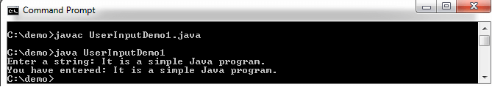
How to take String input in Java
Java nextLine() method
The nextLine() method of Scanner class is used to take a string from the user. It is definedin java.util.Scanner class. The nextLine() method reads the text until the end of the line. After reading the line, it throws the cursor to the next line.
The signature of the method is:
public String nextLine()
The method returns the line that was skipped. It does not accept any parameter. When it does not find any line, then it throws NoSuchElementException. It also throws IllegalStateException if the scanner is closed.
Example of nextLine() method
import java.util.*;
class UserInputDemo1
{
public static void main(String[] args)
{
Scanner sc= new Scanner(System.in); //System.in is a standard input stream
System.out.print("Enter a string: ");
String str= sc.nextLine(); //reads string
System.out.print("You have entered: "+str);
}
}
Output:

Slide 20
Writing console output
PrintStream is an output stream derived from OutputStream, it also implements
the low-level method write( ). Thus, write( ) can be used to write to the console. The simplest
form of write( ) defined by PrintStream is shown here:
void write(int byteval)
This method writes the byte specified by byteval. Although byteval is declared as an integer,
only the low-order eight bits are written. Here is a short example that uses write( ) to output
the character "A" followed by a newline to the screen:
// Demonstrate System.out.write().
class WriteDemo {
public static void main(String args[]) {
int b;
b = 'A';
System.out.write(b);
System.out.write('\n');
}
}
You will not often use write( ) to perform console output (although doing so might be
useful in some situations) because print( ) and println( ) are substantially easier to use.

Slide 21
The PrintWriter Class
Although using System.out to write to the console is acceptable, its use is probably best for debugging purposes or for sample programs, such as those found in this book. For realworld programs, the recommended method of writing to the console when using Java is through a PrintWriter stream. PrintWriter is one of the character-based classes. Using a character-based class for console output makes internationalizing your program easier.
PrintWriter defines several constructors. The one we will use is shown here:
PrintWriter(OutputStream outputStream, boolean flushingOn)
Here, outputStream is an object of type OutputStream, and flushingOn controls whether Java flushes the output stream every time a println( ) method (among others) is called.
If flushingOn is true, flushing automatically takes place. If false, flushing is not automatic.

Slide 22
PrintWriter supports the print( ) and println( ) methods. Thus, you can use these methods
in the same way as you used them with System.out. If an argument is not a simple type, the
PrintWriter methods call the object’s toString( ) method and then display the result.
To write to the console by using a PrintWriter, specify System.out for the output stream
and automatic flushing. For example, this line of code creates a PrintWriter that is
connected to console output:
PrintWriter pw = new PrintWriter(System.out, true);
The following application illustrates using a PrintWriter to handle console output:
// Demonstrate PrintWriter
import java.io.*;
public class PrintWriterDemo {
public static void main(String args[]) {
PrintWriter pw = new PrintWriter(System.out, true);
pw.println("This is a string");
int i = -7;
pw.println(i);
double d = 4.5e-7;
pw.println(d);
}
}
The output from this program is shown here:
This is a string
-7
4.5E-7

Slide 23
Reading and Writing Files
Java provides a number of classes and methods that allow you to read and write files. The purpose of this section is to introduce the basic techniques
that read from and write to a file. Although bytes streams are used, these techniques can be adapted to the character-based streams.
Two of the most often-used stream classes are FileInputStream and FileOutputStream, which create byte streams linked to files. To open a file, you simply create an object of one of these classes, specifying the name of the file as an argument to the constructor. Although both classes support additional constructors, the following are the forms that we will be using:
FileInputStream(String fileName) throws FileNotFoundException
FileOutputStream(String fileName) throws FileNotFoundException
method, which is implemented by both FileInputStream and FileOutputStream. It is shown here: void close( ) throws IOException Closing a file releases the system resources allocated to the file, allowing them to be used by another file. Failure to close a file can result in “memory leaks” because of unused resources remaining allocated.

Slide 24
The following program uses read( ) to input and display the contents of a file that contains ASCII text. The name of the file is specified as a command-line argument.
/* Display a text file.
To use this program, specify the name of the file that you want to see.
For example, to see a file called TEST.TXT,
use the following command line.
java ShowFile TEST.TXT
*/
import java.io.*;
class ShowFile {
public static void main(String args[])
{
int i;
FileInputStream fin;
// First, confirm that a filename has been specified.
if(args.length != 1) {
System.out.println("Usage: ShowFile filename");
return;
}
// Attempt to open the file.
try {
fin = new FileInputStream(args[0]);
} catch(FileNotFoundException e) {
System.out.println("Cannot Open File");
return;
}
// At this point, the file is open and can be read.
// The following reads characters until EOF is encountered.
try {
do {
i = fin.read();
if(i != -1) System.out.print((char) i);
} while(i != -1);
} catch(IOException e) {
System.out.println("Error Reading File");
}
// Close the file.
try {
fin.close();
} catch(IOException e) {
System.out.println("Error Closing File");
}
}
}

Slide 25
In the program, notice the try/catch blocks that handle the I/O errors that might occur. Each I/O operation is monitored for exceptions, and if an exception occurs, it is handled. Be aware that in simple programs or example code, it is common to see I/O exceptions simply thrown out of main( ), as was done in the earlier console I/O examples.
Also, in some real-world code, it can be helpful to let an exception propagate to a calling routine to let the caller know that an I/O operation failed.

Slide 26
Transient | Volatile
The Transient marked variable prevents it from being serialized. | The Volatile marked variable follows happen-before relationship on visibility in multithreaded java program which reduces the risk of memory consistency errors.
It gives control and flexibility over to exclude some object methods from serialization process. | It prevents JVM from doing re-ordering which could compromise synchronization.
During deserialization they are initialized with a default value. | They are not initialized with a default value.
It cannot be used with the static keyword as static variable do not belong to individual instance. During serialization, only object’s current state is concerned. | It can be used with the static keyword.
It cannot be used with the final keyword. Although JVM doesn’t complain about it but during deserialization one will face problem of reinitializing a variable. | It can be used with the final keyword.

Slide 27
What is Applet?
An applet is a Java program that can be embedded into a web page. It runs inside the web browser and works at client side. An applet is embedded in an HTML page using the APPLET or OBJECT tag and hosted on a web server. Applets are used to make the website more dynamic and entertaining.
Important points :
All applets are sub-classes (either directly or indirectly) of java.applet.Applet class.
Applets are not stand-alone programs. Instead, they run within either a web browser or an applet viewer. JDK provides a standard applet viewer tool called applet viewer.
In general, execution of an applet does not begin at main() method.
Output of an applet window is not performed by System.out.println(). Rather it is handled with various AWT methods, such as drawString().

Slide 28
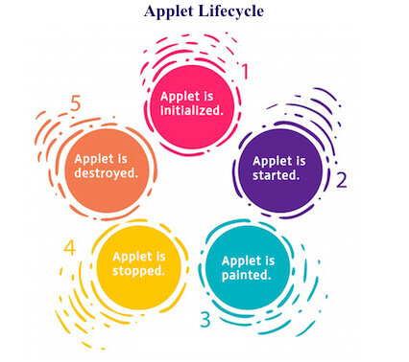
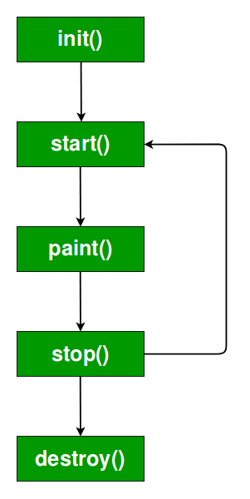
Life cycle of an applet
It is important to understand the order in which the various methods shown in the above image are called. When an applet begins, the following methods are called, in this sequence:
init( )
start( )
paint( )
When an applet is terminated, the following sequence of method calls takes place:
stop( )
destroy( )
Let’s look more closely at these methods.
1. init( ) : The init( ) method is the first method to be called. This is where you should initialize variables. This method is called only once during the run time of your applet.
2. start( ) : The start( ) method is called after init( ). It is also called to restart an applet after it has been stopped. Note that init( ) is called once i.e. when the first time an applet is loaded whereas start( ) is called each time an applet’s HTML document is displayed onscreen. So, if a user leaves a web page and comes back, the applet resumes execution at start( ).

Slide 29
3. paint( ) : The paint( ) method is called each time an AWT-based applet’s output must be redrawn. This situation can occur for several reasons. For example, the window in which the applet is running may be overwritten by another window and then uncovered. Or the applet window may be minimized and then restored. paint( ) is also called when the applet begins execution. Whatever the cause, whenever the applet must redraw its output, paint( ) is called. The paint( ) method has one parameter of type Graphics. This parameter will contain the graphics context, which describes the graphics environment in which the applet is running. This context is used whenever output to the applet is required. Note: This is the only method among all the method mention above, which is parameterized. It’s prototype is public void paint(Graphics g) where g is an object reference of class Graphic.
Now the Question Arises:
Q. In the prototype of paint() method, we have created an object reference without creating its object. But how is it possible to create object reference without creating its object?
Ans. Whenever we pass object reference in arguments then the object will be provided by its caller itself. In this case the caller of paint() method is browser, so it will provide an object. The same thing happens when we create a very basic program in normal Java programs. For Example:
public static void main(String []args){}Here we have created an object reference without creating its object but it still runs because it’s caller,i.e JVM will provide it with an object.

Slide 30
4. stop( ) : The stop( ) method is called when a web browser leaves the HTML document containing the applet—when it goes to another page, for example. When stop( ) is called, the applet is probably running. You should use stop( ) to suspend threads that don’t need to run when the applet is not visible. You can restart them when start( ) is called if the user returns to the page.
5. destroy( ) : The destroy( ) method is called when the environment determines that your applet needs to be removed completely from memory. At this point, you should free up any resources the applet may be using. The stop( ) method is always called before destroy( ).

Slide 31
Advantage of Applet
There are many advantages of applet. They are as follows:
It works at client side so less response time.
Secured
It can be executed by browsers running under many plateforms, including Linux, Windows, Mac Os etc.
Drawback of Applet
Plugin is required at client browser to execute applet.

Slide 32
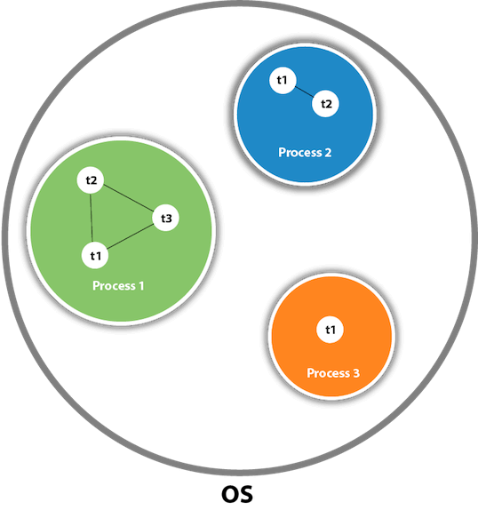
What is Thread in java
A thread is a lightweight subprocess, the smallest unit of processing. It is a separate path of execution.
Threads are independent. If there occurs exception in one thread, it doesn't affect other threads. It uses a shared memory area.
As shown in the above figure, a thread is executed inside the process. There is context-switching between the threads. There can be multiple processes inside the OS, and one process can have multiple threads.

Slide 33
Java Thread class
Java provides Thread class to achieve thread programming. Thread class provides constructors and methods to create and perform operations on a thread. Thread class extends Object class and implements Runnable interface.

Slide 34
Multithreading in Java
It is a process of executing multiple threads simultaneously.
A thread is a lightweight sub-process, the smallest unit of processing. Multiprocessing and multithreading, both are used to achieve multitasking.
However, we use multithreading than multiprocessing because threads use a shared memory area. They don't allocate separate memory area so saves memory, and context-switching between the threads takes less time than process.
Java Multithreading is mostly used in games, animation, etc.

Slide 35
Advantages of Java Multithreading
It doesn't block the user because threads are independent and you can perform multiple operations at the same time.
You can perform many operations together, so it saves time.
Threads are independent, so it doesn't affect other threads if an exception occurs in a single thread.

Slide 36
Multitasking
Multitasking is a process of executing multiple tasks simultaneously. We use multitasking to utilize the CPU. Multitasking can be achieved in two ways:
Process-based Multitasking (Multiprocessing)
Thread-based Multitasking (Multithreading)
1) Process-based Multitasking (Multiprocessing)
Each process has an address in memory. In other words, each process allocates a separate memory area.
A process is heavyweight.
Cost of communication between the process is high.
Switching from one process to another requires some time for saving and loading registers, memory maps, updating lists, etc.
2) Thread-based Multitasking (Multithreading)
Threads share the same address space.
A thread is lightweight.
Cost of communication between the thread is low.

Slide 37
Life cycle of a Thread (Thread States)
In Java, a thread always exists in any one of the following states. These states are:
New
Active
Blocked / Waiting
Timed Waiting
Terminated

Slide 38
Explanation of Different Thread States
New: Whenever a new thread is created, it is always in the new state. For a thread in the new state, the code has not been run yet and thus has not begun its execution.
Active: When a thread invokes the start() method, it moves from the new state to the active state. The active state contains two states within it: one is runnable, and the other is running.
Runnable: A thread, that is ready to run is then moved to the runnable state. In the runnable state, the thread may be running or may be ready to run at any given instant of time. It is the duty of the thread scheduler to provide the thread time to run, i.e., moving the thread the running state.
A program implementing multithreading acquires a fixed slice of time to each individual thread. Each and every thread runs for a short span of time and when that allocated time slice is over, the thread voluntarily gives up the CPU to the other thread, so that the other threads can also run for their slice of time. Whenever such a scenario occurs, all those threads that are willing to run, waiting for their turn to run, lie in the runnable state. In the runnable state, there is a queue where the threads lie.
Running: When the thread gets the CPU, it moves from the runnable to the running state. Generally, the most common change in the state of a thread is from runnable to running and again back to runnable.
Blocked or Waiting: Whenever a thread is inactive for a span of time (not permanently) then, either the thread is in the blocked state or is in the waiting state.

Slide 39
For example, a thread (let's say its name is A) may want to print some data from the printer. However, at the same time, the other thread (let's say its name is B) is using the printer to print some data. Therefore, thread A has to wait for thread B to use the printer. Thus, thread A is in the blocked state. A thread in the blocked state is unable to perform any execution and thus never consume any cycle of the Central Processing Unit (CPU). Hence, we can say that thread A remains idle until the thread scheduler reactivates thread A, which is in the waiting or blocked state.
When the main thread invokes the join() method then, it is said that the main thread is in the waiting state. The main thread then waits for the child threads to complete their tasks. When the child threads complete their job, a notification is sent to the main thread, which again moves the thread from waiting to the active state.
If there are a lot of threads in the waiting or blocked state, then it is the duty of the thread scheduler to determine which thread to choose and which one to reject, and the chosen thread is then given the opportunity to run.

Slide 40
Timed Waiting: Sometimes, waiting for leads to starvation. For example, a thread (its name is A) has entered the critical section of a code and is not willing to leave that critical section. In such a scenario, another thread (its name is B) has to wait forever, which leads to starvation. To avoid such scenario, a timed waiting state is given to thread B. Thus, thread lies in the waiting state for a specific span of time, and not forever. A real example of timed waiting is when we invoke the sleep() method on a specific thread. The sleep() method puts the thread in the timed wait state. After the time runs out, the thread wakes up and start its execution from when it has left earlier.
Terminated: A thread reaches the termination state because of the following reasons:
When a thread has finished its job, then it exists or terminates normally.
Abnormal termination: It occurs when some unusual events such as an unhandled exception or segmentation fault.
A terminated thread means the thread is no more in the system. In other words, the thread is dead, and there is no way one can respawn (active after kill) the dead thread.

Slide 41
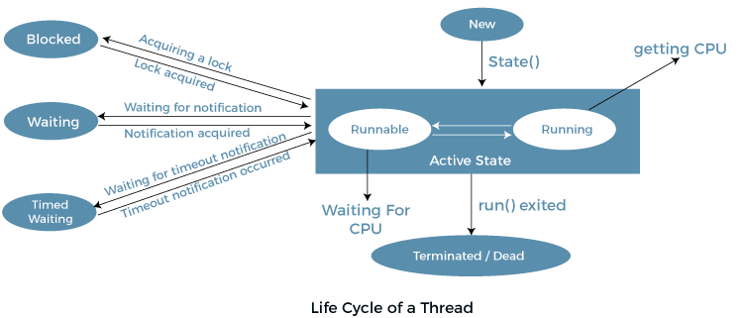
The following diagram shows the different states involved in the life cycle of a thread.

Slide 42
Creating a Thread
In the most general sense, you create a thread by instantiating an object of type Thread. Java defines two ways in which this can be accomplished:
You can implement the Runnable interface. You can extend the Thread class, itself.
The following two sections look at each method, in turn.
Implementing Runnable
The easiest way to create a thread is to create a class that implements the Runnable
interface. Runnable abstracts a unit of executable code. You can construct a thread on any
object that implements Runnable. To implement Runnable, a class need only implement a
single method called run( ), which is declared like this:
public void run( )
Inside run( ), you will define the code that constitutes the new thread. It is important to
understand that run( ) can call other methods, use other classes, and declare variables, just like
the main thread can. The only difference is that run( ) establishes the entry point for another,
concurrent thread of execution within your program. This thread will end when run( )
returns.

Slide 43
After you create a class that implements Runnable, you will instantiate an object of type Thread from within that class. Thread defines several constructors. The one that we will use is shown here:
Thread(Runnable threadOb, String threadName)
In this constructor, threadOb is an instance of a class that implements the Runnable interface. This defines where execution of the thread will begin. The name of the new thread is specified by threadName.
After the new thread is created, it will not start running until you call its start( ) method, which is declared within Thread. In essence, start( ) executes a call to run( ). The start( ) method is shown here:
void start( )

Slide 44
Here is an example that creates a new thread and starts it running:
// Create a second thread.
class NewThread implements Runnable {
Thread t;
NewThread() {
// Create a new, second thread
t = new Thread(this, "Demo Thread");
System.out.println("Child thread: " + t);
t.start(); // Start the thread
}
// This is the entry point for the second thread.
public void run() {
try {
for(int i = 5; i > 0; i--) {
System.out.println("Child Thread: " + i);
Thread.sleep(500);
}
} catch (InterruptedException e) {
System.out.println("Child interrupted.");
}
System.out.println("Exiting child thread.");
}
}
class ThreadDemo {
public static void main(String args[ ] ) {
new NewThread(); // create a new thread
try {
for(int i = 5; i > 0; i--) {
System.out.println("Main Thread: " + i);
Thread.sleep(1000);
}
} catch (InterruptedException e) {
System.out.println("Main thread interrupted.");
}
System.out.println("Main thread exiting.");
}
}
Inside NewThread’s constructor, a new Thread object is created by the following statement:
t = new Thread(this, "Demo Thread");

Slide 45
Passing this as the first argument indicates that you want the new thread to call the run( )
method on this object. Next, start( ) is called, which starts the thread of execution
beginning at the run( ) method. This causes the child thread’s for loop to begin. After
calling start( ), NewThread’s constructor returns to main( ). When the main thread
resumes, it enters its for loop. Both threads continue running, sharing the CPU in singlecore systems, until their loops finish. The output produced by this program is as follows.
(Your output may vary based upon the specific execution environment.)
Child thread: Thread[Demo Thread,5,main]
Main Thread: 5
Child Thread: 5
Child Thread: 4
Main Thread: 4
Child Thread: 3
Child Thread: 2
Main Thread: 3
Child Thread: 1
Exiting child thread.
Main Thread: 2
Main Thread: 1
Main thread exiting.
As mentioned earlier, in a multithreaded program, often the main thread must be the
last thread to finish running

Slide 46
The Thread Class and the Runnable Interface
Java’s multithreading system is built upon the Thread class, its methods, and its companion interface, Runnable. Thread encapsulates a thread of execution. Since you can’t directly refer to the ethereal state of a running thread, you will deal with it through its proxy, the Thread instance that spawned it. To create a new thread, your program will either extend
Thread or implement the Runnable interface.
The Thread class defines several methods that help manage threads. Several of those used in this chapter are shown here:

Slide 47
